Slide 1
Part 2 A Generic Process view

Slide 2
Topics
A Layered Technology
Process Framework
Process Models All Types of Process Models
CMMI Model
The Unified Process, Process and Product
Agile Development and Extreme Programming

Slide 3
A Layered Technology Software Engineering Layers
.
Layered Technology
Tools:
Methods: technical
Process model: the “framework”
A quality focus: the “bedrock”

Slide 4
Tools: Provide automated or semi-automated support for the process, methods and quality control. When tools are integrated so that information created by one tool can be used by another, a system for the support of software development, called computer-aided software engineering (CASE)
Methods:
It provide the technical how-to's for building software.
Methods encompass a broad array of tasks that include requirements analysis, design, program construction, testing, and support.
There could be more than one technique to perform a task and different techniques could be used in different situations.
Process:
It’s a foundation layer for software engineering.
It’s define framework for a set of key process areas for effectively manage and deliver quality software in a cost effective manner
The processes define the tasks to be performed and the order in which they are to be performed
A Quality Focus
It defines the continuous process improvement principles of software. It provides integrity that means providing security to the software so that data can be accessed by only an authorized person, no outsider can access the data. It also focuses on maintainability and usability

Slide 5
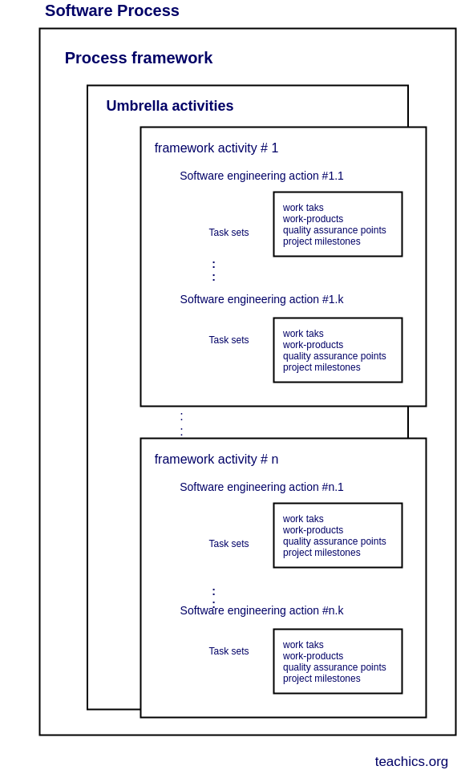
A Generic Process Models S/w Process Frame Work
Software Process:
A s/w process is defined as a collection of
a) Work Activities – group of related tasks & actions for major objective
b) Actions – set of tasks that produce a major work product
c) Tasks – focus on small and specific objective
That are performed when some work product is created.
Each of these activities, actions and tasks reside within a framework
Or model that defines their relationship with the process and with one
Another
The s/w process compromises activities performed to create a s/w
Product, it deals with technical and management aspects of s/w
Development
S/w process framework is an abstraction of the s/w development process

Slide 6
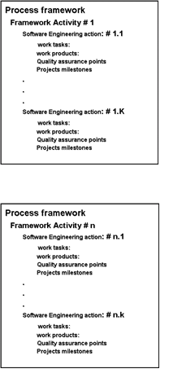
Process Framework
A generic process framework for s/w engineering defines five framework activities
a) Communication
b) planning
c) Modelling
d) Construction
e) Deployment
With this, the following are umbrella activities
a) project tracking and control
b) risk management
c) quality assurance
d) configuration management
e) technical reviews and others are applied through out the process
Framework activities:
Communication: Communicate with stakeholders and customers to obtain objectives of the system
and requirements for the software.
Planning :Software project plan has details of resources needed, tasks and risk factors likely to occur,
schedule.

Slide 7
Conti..
c) Modelling: Architectural models and design to better understand the problem and for work towards the best solution.
d) Construction – Generation of code and testing of the system to rectify errors and ensuring all specified requirements are met.
e) Deployment – Entire software product or partially completed product is delivered to the customer for evaluation and feedback.
Umbrella Activities:
a) Software project tracking and control – Compare the progress of the project with the plan and take steps to maintain a planned schedule.
Risk management – Evaluate risks that can affect the outcome and quality of the software product.
Software quality assurance (SQA) – Conduct activities to ensure the quality of the product.
Technical reviews – Assessment of errors and correction done at each stage of activity.
Measurement – All the measurements of the project and product features.
Software configuration management (SCM) – Controlling and tracking changes in the software.
Reusability management – Back up work products for reuse and apply the mechanism to achieve reusable software components.
Work product preparation and production – Project planning and other activities used to create work product are documented.

Slide 8
Process flow
It defines as how the flow occurs between framework activities, actions and tasks within each framework activity are organized with respect to time and sequence
Linear Process flow: it executes each of the five framework activities in sequence beginning with communication and culminating with deployment
Iterative Process flow: it repeats one or more activities before proceeding to the next
Communication
Planning
Modelling
construction
Deployment
communication
Planning
Modelling
construction
Deployment

Slide 9
Conti..
C) Evolutionary process flow:
The flow executes the activities in a circular manner.
Increment
released
planning
Communication
Modelling
deployment
construction

Slide 10
Conti..
D) Parallel process flow
This flow executes one or more activities in parallel with other activities
Time
communication
planning
Modelling
construction
deployment

Slide 11
Conti.. Defining a framework activity
To get into detail about the processing frame work activities the s/w team significantly should know more information about the nature of the problem, size of the project, requirement of stakeholders and so on.
Therefore the necessary actions is phone conversation and the work tasks( task set)
The task set for small project is
a) make contact with stake holder via telephone
b) discuss requirements and take notes
c) organize notes into brief written statement of requirements
d) E-mail to stake holder for review and approval
For large projects extraneous steps may be added to elicitation such as interviewing each stakeholder separately before the group meeting, more techniques are applied in discussing requirement
Identifying a task set
A task set defines actual work to be done to accomplish the objectives of s/w engineering actions.
Example: elicitation or requirements gathering. The goal of requirements gathering is to understand various what various stakeholders want from the s/w that is to be built

Slide 12
Conti..
Process patterns
A process pattern describes a process related problem that is encountered during s/w engineering work, identifies the environment in which the problem has been encountered & suggests one or more proven solutions to the problem.
Patterns can be defines at any level of abstraction.
The template for describing a process pattern is as follows:
Pattern name
Forces
Type
a) stage pattern- defines a problem associated with framework activity for the process.
Eg: Establishing communication
b) task pattern- defines a problem associated with a s/w engineering action or work task and relevant to successful s/w engineering practice (eg; requirements gathering)
c) phase pattern- define the sequence of framework activities that occur within the process, even when the overall flow of activities is iterative in nature. (eg; spiral model or prototyping)
Process patterns provide an effective mechanism for addressing problems associated with any s/w process.

Slide 13
NEXT TOPIC Process Assessment and Improvement
A software process assessment is a disciplined examination of the software processes used by an organization, based on a process model.
The assessment includes the identification and characterization of current practices, identifying areas of strengths and weaknesses, and the ability of current practices to control or avoid significant causes of poor (software) quality, cost, and schedule.
The existence of a s/w process is no guarantee that s/w will be delivered on time, that it will meet customer needs or it will exhibit technical characteristics that will lead to long term quality characteristics
A number of different approaches to s/w process assessment and improvement have been proposed over the past few decades.
Standard CMMI Assessment method for process improvement (SCAMPI)
The Software Engineering Institute (SEI) has developed process meta-model to measure organization different level of process capability and maturity
The CMMI defines each process area in terms of “specific goals” and the “specific practices” required to achieve these goals.
Specific goals establish the characteristics that must exist if the activities implied by a process area are to be effective.
Specific practices refine a goal into a set of process-related activities.
SCAMPI provides a five step process assessment model that incorporates five phases

Slide 14
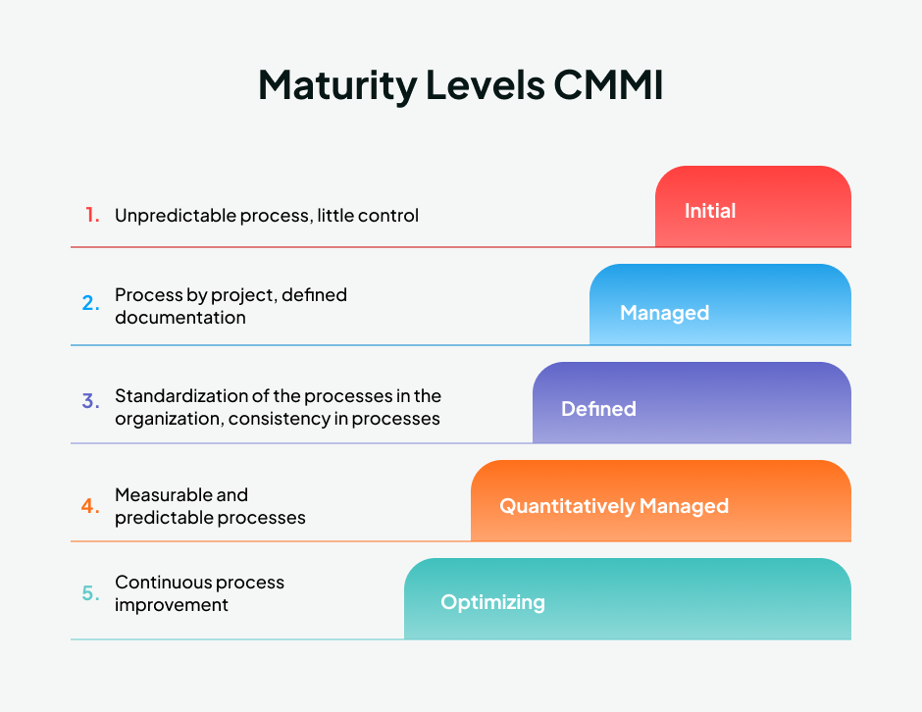
Conti.. CMMI Model
Level 1 | Incomplete
Level 1 | Initial
Level 2 | Managed
Level 3 | Defined
Level 4 | Quantitatively Managed
Level 5 | Optimizing

Slide 15
Conti..
CMMI is a process level improvement training and appraisal program.
CMMI is a process model that guides organizations to improve process and boosts productivity
It also helps organizations streamline process improvement, encouraging a productive, efficient culture that decreases risks in s/w, product and service development.
CMMI Levels
Level 1– Incomplete/initial:
At this stage work “may or may not get completed.” Goals have not been established at this point and processes are only partly formed or do not meet the organizational needs.
Level 1a –
Initial:
Processes are viewed as unpredictable and reactive. At this stage, “work gets completed but it’s often delayed and over budget.” This is the worst stage a business can find itself in — an unpredictable environment that increases risk and inefficiency.
Level 2 – Managed:
There’s a level of project management achieved. Projects are “planned, performed, measured and controlled” at this level, but there are still a lot of issues to address.

Slide 16
Conti..
Level 3 – Defined:
At this stage, organizations are more proactive than reactive. There’s a set of “organization-wide standards” to “provide guidance across projects, programs and portfolios.” Businesses understand their shortcomings, how to address them and what the goal is for improvement.
Level 4 – Quantitatively managed:
This stage is more measured and controlled. The organization is working off quantitative data to determine predictable processes that align with stakeholder needs. The business is ahead of risks, with more data-driven insight into process deficiencies.
Level 5 – Optimizing:
Here, an organization’s processes are stable and flexible. At this final stage, an organization will be in constant state of improving and responding to changes or other opportunities. The organization is stable, which allows for more “agility and innovation,” in a predictable environment.

Slide 17
Process models SDLC

Slide 18
SDLC
SDLC stands for software development life cycle.
It outlines the numerous steps needed in creating software to produce a high quality end product
It consists of mainly 3 stages
a) conception phase- Feasibility study of requirements and planning
b) Implementation phase – Design ,coding and Implementation
c) Maintenance phase – Deploying and maintenance
planning
Deploy/Maintenance
Define/Analysis
Testing
Design
Coding/Implementation

Slide 19
Planning/Feasibility study:
The first phase is the requirements gathering and analysis phase, where the customer’s requirements for the software are gathered and analyzed to determine the scope of the project.

Slide 20
Waterfall model
The waterfall model is a continuous s/w development model in which development is seen as flowing steadily downwards through the steps of requirements analysis, design, implementation, testing, integration and maintenance
The waterfall model is also known as classic life cycle model which suggests a systematic, sequential approach to s/w development that begins with the flow from communication to deployment
This model is the first or earliest SDLC approach that was used for s/w development process
In this model, each phase must be completed before the next phase begin, and this model is very simple to use and understand
Communication/requirements
Planning/analysis
Modelling/design
Construction/Implementation
Testing/Deployment

Slide 21
Conti.. waterfall model
Advantages (when to use) | Disadvantages
1.Requirements are clear and fixed that may not change | 1. The waterfall model requires lot of time
2.The requirements are unambiguous nature in this model | 2. Requirements gathering should be clear in the requirements phase itself
3.It is good to use this model if the technology is understood properly | 3. Risk is high if requirements are uncertain or not clear at early phase
4.This model works well for small projects and cost of using this model is low | 4. This model is not efficient if the project is complex or it is object oriented
5.Risk is minimum or zero by using this model | 5. It is difficult to measure progress within stages
6. Each phase’s deliverables are well specified | 6.Real projects rarely follow sequential flow that the model proposes.

Slide 22
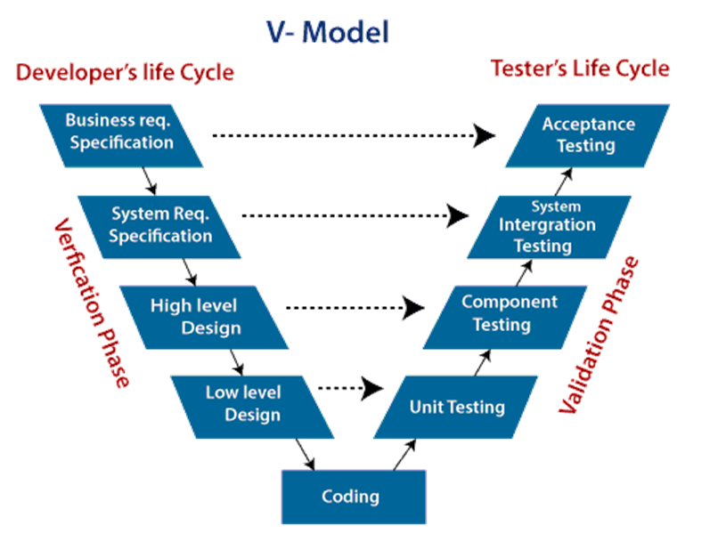
V Model
A Variation in waterfall model represented as V model. In this model the process executes in sequential manner in a V shape
V Model also known as verification and validation model.
The V model depicts the relationship of quality assurance actions associated with communication, modelling and early construction activities.
As a s/w team moves down the left side of V, basic problem requirements are refined into progressively more detailed and technical representations of the problem and its solution.
Once the code has been generated the team moves up right side of the V
Then it performs a series of quality assurance tests that validate(test) each of the models created as the team moved down the left side.
In real time there is no fundamental difference between waterfall model and the V-model, the V model provides a way of visualizing how verification and validation actions (V Model) are applied to earlier engineering work.

Slide 23
Conti.. There are two phases in this V model a) Verification Phase– Requirement analysis, Architectural design, component design, code generation b) Validation phase – Unit testing, Integration testing, System testing, Acceptance testing
When to Use | Advantages | Disadvantages
1.If Requirements are clearly defined and fixed | In this model, the phases are completed one at a time | High risk and uncertainty
2.Smaller to medium sized projects | It is simple and easy to understand | It is not good for complex projects and object oriented concepts
3. It is used when the ample technical resources are available with the technical expertise | This model focuses on verification and validation activities early in the life cycle thereby enhancing the probability of building an error-free and good quality product. | The V-Model places a strong emphasis on documentation, which can lead to an overreliance on documentation at the expense of actual development work.
4.Since It is challenging to keep the needs stable in large projects, the project should be small | It is clear and structured process and also it emphasis on testing | Inflexibility and time consuming

Slide 24
Incremental Model
The incremental model delivers a series of releases, called increments, that provide progressively more functionality for the customer as each increment is delivered.
The incremental model combines elements of linear and parallel process flows
a) linear flow – executes each of 5 framework activities in sequence
b) parallel flow – executes one or more activities in parallel with other activities
In Fig
1. Communication
4. Construction
2. Planning
3. Modelling 5. Deployment
increment #n
software functionality and features
delivery of n increments
increment #2
delivery of 2nd increment
increment #1
delivery of 1st increment
project calendar time

Slide 25
Conti.. Incremental model
Referring to figure, the incremental model applies linear sequences in a staggered fashion as calendar time progresses
Each linear sequence produces deliverable “increments” of the s/w in a manner that is similar to the increments produced by an evolutionary process flow
When an increment is used the first increment often a core product and the core product is used by the customer
As a result of use and evaluation a plan is developed for the next increment.
The plan addresses the modification of the core product to better meet the needs of the customer and the delivery of additional features and functionality.
The process is repeated following the delivery of each increment until the complete product is produced
The incremental model focuses on the delivery of an operational product with each increment.
Early increments are stripped down versions of the final product

Slide 26
Conti.. The incremental model philosophy is used for all “Agile Process Models”
When to use | Advantages | disadvantages
If the requirements are clearly defined and well understood | Interaction with the customer at every is stage happens | Needs good effective planning
When the customer demands for quick release of project | Simple and easy to implement | It can be easy to use when the requirements are clear and understood
The customer should know the exact requirements at earlier stage | Cost is low and the product delivery is fast | More cost and time is needed
When the s/w team are not very well trained or skilled | More flexible and easy to debug/testing | Well define module interfaces are needed
A project is large and risk is high

Slide 27
RAD (Rapid Application Development Model)
RAD is a linear sequential software development process model that emphasizes a concise development cycle using an element based construction approach.
If the requirements are well understood and described, and the project scope is a constraint, the RAD process enables a development team to create a fully functional system within a concise time period.
RAD (Rapid Application Development) is a concept that products can be developed faster and of higher quality through:
Gathering requirements using workshops or focus groups
Prototyping and early, reiterative user testing of designs
The re-use of software components
A rigidly paced schedule that refers design improvements to the next product version
Less formality in reviews and other team communication

Slide 28
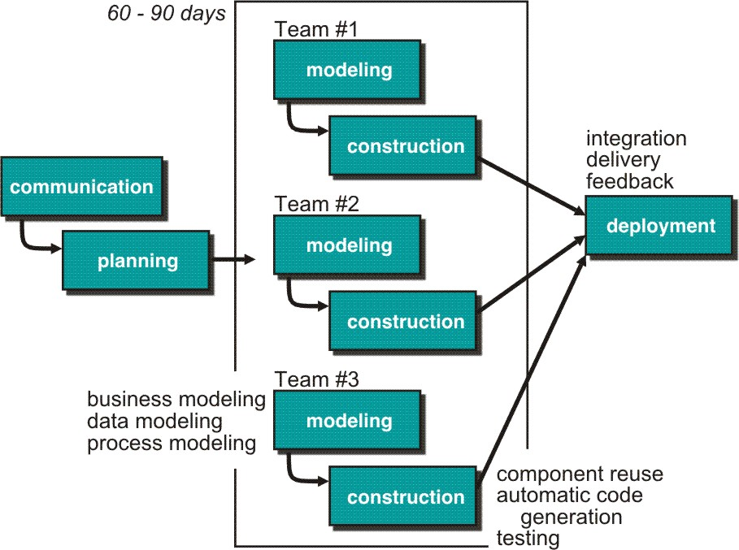
Conti.. RAD
Communication – to understand business problem.
Planning – multiple s/w teams works in parallel on diff. system.
Modeling –
Business modeling – Information flow among business is working.
Ex. What kind of information drives?
Who is going to generate information?
From where information comes and goes?
Data modeling – Information refine into set of data objects that are needed to support business.
Process modeling – Data object transforms to information flow necessary to implement business.
Construction – it highlighting the use of pre-existing software component.
Deployment – Deliver to customer basis for subsequent iteration.

Slide 29
Conti.. RAD
When to use | Advantages | Disadvantages
When the system should need to create the project that modularizes in a short span time (2-3 months). | Each phase in RAD brings highest priority functionality to the customer. | It required highly skilled designers.
When the requirements are well-known and technical risk is limited. | It reduced development time and increases the reusability of features. | All application is not compatible with RAD. And for smaller projects, we cannot use the RAD model.
It should be used only if the budget allows the use of automatic code generating tools. | This model is flexible for change. | On the high technical risk, it's not suitable. As it requires user involvement.
RAD model emphasize a short development cycle.
“High speed” edition of linear sequential model.
If requirement are well understood and project scope is constrained then it enable development team to create “ fully functional system” within a very short time period.
If application is modularized (“Scalable Scope”), each major function to be completed in less than three months.
Each major function can be addressed by a separate team and then integrated to form a whole.

Slide 30
Evolutionary models
Evolutionary models are a combination of Iterative and Incremental models of SDLC
Incremental model first implement a few basic features and deliver to the customer
Then it builds the next part and delivered it again and repeat this step until the desired system is completed
Iterative model is called as a feedback process in every phase
Evolutionary models are iterative
The types of evolutionary models
a) Prototype model
b) Spiral model
c) concurrent models
Iterative model
In this model, we can start with some of the s/w applications and develop the first version of the s/w.
After the first version if there is need to change the s/w then a new version of the s/w is crested with a new iteration
Every release of the iterative model finishes in an exact and fixed period that is called iteration
The iterative model allows the accessing earlier phase, in which the variations made respectively
The final output of the project renewed at the end of the SDLC process

Slide 31
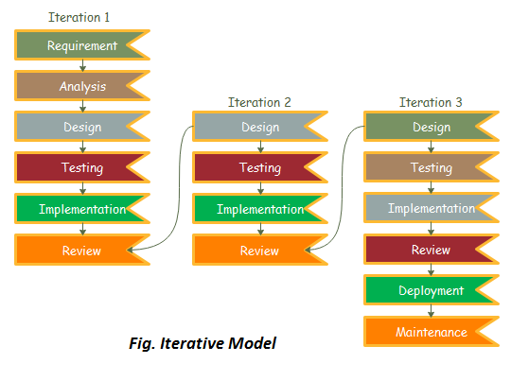
Conti..
When to use | Advantages | disadvantages
If requirements are clearly and easy to understand | Testing and debugging in every phase is easy | It is not suitable for smaller projects
The s/w application is large | A parallel development can plan | Changing of requirements frequently may cause over budget
If the requirements are going to change in future | Risks are identified and resolved in every iteration | Project completion date not confirmed because of changing requirements frequently
 | Client can change the needs of the project easily | More resources may be required

Slide 32
Conti.. evolutionary models
Prototype model
Prototype model is a stand alone process model, it is more commonly used as a technique that can be implemented within the context of any one of the process models.
The prototype paradigm assists you and other stack holders to better understand what is to be build when requirements are fuzzy
The prototyping paradigm begins with the communication phase (requirements phase)
The prototyping model requires that before carrying out the development of actual s/w, a working prototype of the system should be built
Ideally, the prototype model serves as a mechanism for identifying s/w requirements. If a working prototype is to build, you can make use of existing program fragments or apply tools that enable working programs to be generate quickly
The prototype can serve as the first system”
Steps of prototype model
Requirement Gathering and Analyst
Quick Decision
Build a Prototype
Assessment or User Evaluation
Prototype Refinement
Engineer Product

Slide 33
Conti.. Prototype model
When to use this model?
Developer may be unsure of the efficiency of an
Algorithm, the adaptability of an operating system,
Or the form that human machine interaction should take.
In these and many other situations a prototype paradigm
May offer the best approach
Communication
Quick plan
Deployment delivery
And feedback
Modelling and quick design
Advantages | disadvantages
Reduce the risk of incorrect user requirements | Prototyping tools are expensive
Errors can be detected earlier as the system is made side by side | It requires extensive customer collaboration
Supports early product marketing | Special tools and techniques are required to build a prototype
Construction of prototype

Slide 34
Spiral model
This model originally proposed by Barry Bohem
The spiral model is an evolutionary s/w model that couples the iterative nature of prototyping with the controlled and systematic aspects of the waterfall model
It provides the potential for rapid development of increasingly more complete versions of the s/w
The spiral development model is a risk-driven process model generator that is used to guide multi stakeholder concurrent engineering of s/w intensive systems
It has mainly two distinguished feature
a) cyclic approach- for incrementally growing a system’s degree of definition and implementation while decreasing its degree of risk.
b) Anchor point- a set of anchor point milestones for ensuring stakeholder commitment of feasible and mutually satisfactory system solutions
Using this model, s/w developed in a series of evolutionary releases
During early iterations, the release might be a model or prototype
During later iterations, increasingly more complete versions of the engineered system are produced
The spiral model can be adapted to apply though out the entire life cycle of an application, from concept development to maintenance

Slide 35

Conti.. Spiral model
A spiral model is divided into set of framework activities defined by s/w engineering team
Each of the framework activities represent one segment of the spiral path
As this evolutionary process begins, the s/w team perform activities that are implied by a circuit around the spiral in clockwise direction, beginning at the center
Risk is considered as each evolution made
Anchor point milestones- a combination of work products and conditions that are attained along the path of the spiral
The first circuit around the spiral might result in the development of a product specification
Subsequent passes around the spiral might be used to develop a prototype and then progressively more sophisticated versions of the s/w
Cost and schedule are adjusted based on feedback derived from the customer after delivery
Planning estimation scheduled risk analysis
Communication
Modelling analysis design
Deployment delivery feed back
Construction Code test

Slide 36
Conti.. spiral
Unlike other process models that end when s/w is delivered, the spiral model can adapted to apply through out the life cycle of the computer s/w
Therefore the first circuit around the spiral might represent a “concept development project” that starts at the core of the spiral and continues for multiple iterations until concept development is complete
the arrows pointing inwards along axis separating the deployment region from the communication region indicate a potential for local iteration along the same spiral path
The spiral model is a realistic approach to the development of large scale systems and s/w because s/w evolves as the process progresses, the developer and customer better understand and react to risks at each evolutionary level
When to use | Advantages | Disadvantages
If the project is large and risk is more in large projects this model can be used | This model considers technical risks at all stages of the project before they become problematic | Some times it may difficult to convince customers that the evolutionary approach is controllable
If the requirements are unclear and complex then this model is applicable | It maintains both classic life cycle approach and iterative framework more realistically | This model can not handle the major risks that are uncovered and managed at earlier stages 3. Doesn’t work well for small projects and also it is very expensive to implement

Slide 37
Concurrent models
inactive
Requirements the state of a s/w engineering activity or task
The concurrent model, also called as concurrent engineering, allows a s/w team a represent iterative and concurrent elements of any of the process models
In fig, provides a schematic representation of one s/w engineering activity within the modelling activity using a concurrent modelling approach
The activity Modelling may be in any one of the states noted at any given time
Similarly the other activities actions and tasks can be represented in an analogous manner
All s/w engineering activities exist concurrently but reside in different states
A state is some externally observable mode of behavior
Concurrent modeling defines a series of events that will trigger transitions from state to state for each of the s/w engineering activities, actions or tasks.
Under development
Awaiting changes
Under review
Under revision
Base lined
done

Slide 38
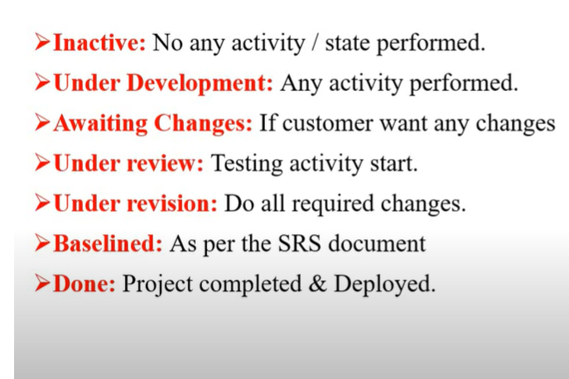

Slide 39
Conti.. Concurrent model
Awaiting changes state – after completion of first iteration and it exits in this state
inactive state– the modelling activity which existed in inactive state while initial communication was completed, now makes a transition into under development state
If the customer indicates that changes in requirements must be made, the modelling activity moves from the under development state into awaiting changes state
During early stages of design an inconsistency in requirement model is un covered. This generates the event analysis model correction which will trigger requirement analysis action from the done state into awaiting state
Concurrent modelling is applicable to all types of s/w development and provides an accurate picture of the current state of a project
It defines a process network rather than confining s/w engineering activities, actions and tasks to a sequence of events
Advantages | Disadvantages
This model is applicable to all types of software development processes. | It needs better communication between the team members. This may not be achieved all the time
• It is easy for understanding and use. | It requires to remember the status of the different activities.
It gives immediate feedback from testing.
• It provides an accurate picture of the current state of a project.

Slide 40
Component model
component-based development (CBD) model incorporates many of the characteristics of the spiral model.
It is evolutionary by nature and iterative approach to create software.
CBD model creates applications from prepackaged software components (called classes).
Modeling and construction activities begin with identification of candidate components.
Classes created in past software engineering projects are stored in a class library or repository.
Once candidate classes are identified, the class library is searched to determine if these classes already exist.
If class is already available in library extract and reuse it.
If class is not available in library, it is engineered or developed using object-oriented methods.
Any new classes built to meet the unique needs of the application.
Now process flow return to the spiral activity.
CBD model leads to software reusability.
Based on studies, CBD model leads to 70 % reduction in development cycle time. 84% reduction in project cost.
Productivity is very high.

Slide 41
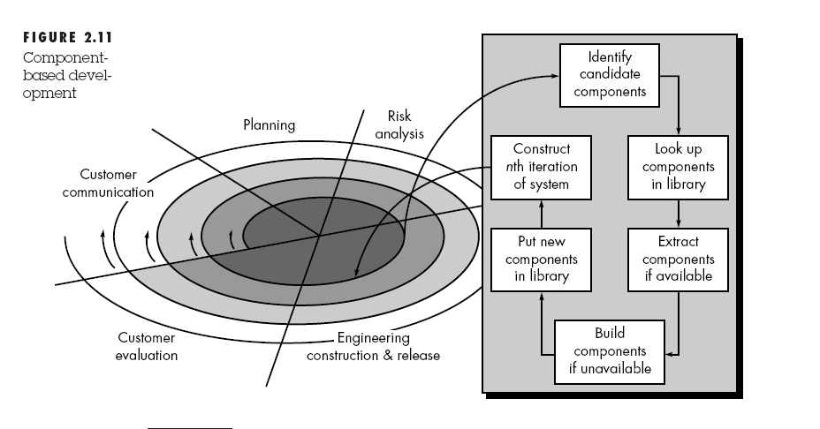
Conti..

Slide 42
Unified process
The Unified Process (UP) is a software development framework used for object-oriented modeling.
The framework is also known as Rational Unified Process (RUP) and the Open Unified Process (Open UP). Some of the key features of this process include:
It defines the order of phases.
I) It is component-based, meaning a software system is built as a set of software components. There must be well-defined interfaces between the components for smooth communication.
ii) It follows an iterative, incremental, architecture-centric, and use-case driven approach
The unified process recognizes the importance of customer communication and streamlined methods for describing the customer’s view of the system (“The use case”)
It emphasizes the important role of s/w architecture
The scientists began working on a “unified method” that combine the best feature of their individual object-oriented analysis and design methods and adopted additional features proposed in object oriented modelling
The result was “unified process modelling language UML” which contains robust notation for modelling and development of object oriented systems
The unified process is sometimes also called as “RUP” rational unified process after the rational corporation ,(IBM) an early contributor to the development and refinement of UP(unified process)) and a builder of complete environment (tools &technology) that support the process

Slide 43
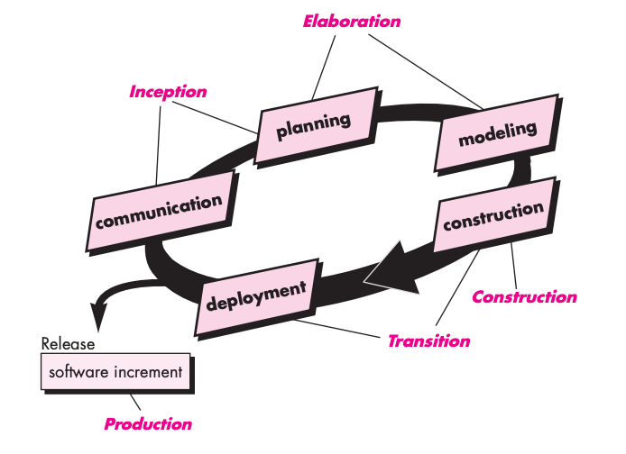
conti.. Unified process
We can represent a unified process model as a series of cycles. Each cycle ends with the release of a new system version for the customers. We have five phases in every cycle:
a) Inception phase
b) Elaboration phase
C) Construction phase
D) Transition phase
e) Production phase
Inception Phase
This phase encompasses both customer and planning activities
By collaborating with stakeholders, business requirements for s/w are identified
A rough architecture for the system is proposed
It plans for iterative, incremental nature of the ensuring project is developed
Fundamental business requirements are described through out a set of preliminary use cases
Fig: Unified Process

Slide 44
Conti.. unified process
The main goal of this phase involves delimiting the project scope.
This is where we define why we are making this product in the first place. It should have the following:
What are the key features?
How does this benefit the customers?
Which methodology will we follow?
What are the risks involved in executing the project?
Schedule and cost estimates.
Elaboration phase:
It encompasses the communication and modelling activities of generic process model
Elaboration refines and expands the preliminary use cases that were developed as part of the inception phase and expands the architectural representation to include five different views of the s/w – the use case model, the requirement model, the design model, the implementation and deployments models.
Elaboration phase also creates an “executable architectural baseline” that represents a “first cut” executable system
This architectural baselines demonstrates only the viability of the architecture but does not provide all features and functions required to use the system
In addition, the plan is carefully reviewed at the culmination of the elaboration phase to ensure that scope, risk and delivery dates remain reasonable
In this phase, the architectural baseline is not a prototype, rather the baseline is fleshed out during the next phase

Slide 45
Conti..
Construction phase
This phase is identical to the construction activity defined for the generic s/w process
The input is considering from architectural model and it develops the s/w components that will make each use case operational for end users
To achieve the output of this phase requirements and design model that were started during the elaboration phase are completed and reflect the final version of the s/w increment
As components are being implemented, unit tests are designed and executed for each
In addition to this, component assembly and integration testing are conducted
For acceptance testing, use cases are used to derive and executed prior to the initiation of the next unified process phase(UP phase)
Transition phase
This phase encompasses the latter stages of the generic construction activity and the first part of generic deployment (delivery & feedback) activity
s/w is given to end users for beta testing and user feedback reports both defects and necessary changes
In this phase, in addition to testing s/w team creates user manuals, trouble shooting guides, installation procedures that is required for the release of the product
At the conclusion of the transition phase, the s/w increment becomes a usable s/w release

Slide 46
Production phase
The production phase of UP coincides with the deployment activity of the generic process
During this phase, the ongoing use of the s/w is monitored, support for the operating environment or infrastructure is provided, defects reports and request for changes are submitted and evaluated
These five UP phases do not occur sequentially rather it was with staggered concurrency
A s/w engineering workflow is disturbed across all the UP phases
Inception phase
Elaboration phase
Construction phase
Transition phase
Production phase

Slide 47
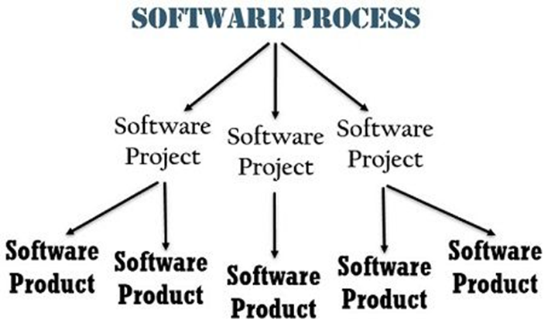
Process and Product
Process :
Insights of process paradigm, s/w engineering tasks, work product or mile stones
lead to long term process improvement
process is used to create a project
process is treated as evolution of steps to produce the project
Product:
assesses the state of the project
track potential risks
uncover problem areas
adjust workflow or tasks
Evaluate teams ability to control quality
it is known as end of the project as it focus on end of the result

Slide 48
Agile Development
Agile software engineering combines a philosophy and a set of development guidelines.
The development stress delivery over analysis and design, and active and continuous communication between developers and customer.
s/w engineers and other project stakeholders (managers, customers and users) work together on an agile team.
Agile team- a team that is self organizing and in control of its own destiny
An agile team fasters communication and collaboration among all who serve on it
Agile s/w engineering represents a reasonable alternative to conventional s/w engineering for certain classes of s/w and certain types of s/w projects
Agile methods are sometimes referred to as light methods or lean methods
Agility is dynamic content specific aggressively change embracing and growth oriented
An agile process reduces the cost of change because s/w is released in increments and change can better controlled within an increment
Agile process
• Agility Principals
• Human Factors

Slide 49
Agility principles
The highest priority of this process is to satisfy the customer.
Acceptance of changing requirement even late in development.
Frequently deliver a working software in small time span.
Throughout the project business people and developers work together on daily basis.
Projects are created around motivated people if they are given the proper environment and support.
Face to face interaction is the most efficient method of moving information in the development team.
Primary measure of progress is a working software.
Agile process helps in sustainable development.
Continuous attention to technical excellence and good design increases agility.
From self organizing teams the best architecture, design and requirements are emerged.
Simplicity is necessary in development.

Slide 50
Human Factors
Competence
Common focus
Collaboration
Decision making ability
Fuzzy problem-solving ability
Mutual trust and respect
Self organization

Slide 51
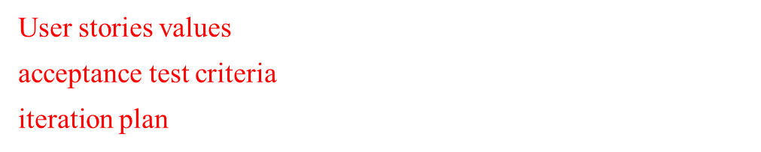
Extreme programming
Simple design CRC cards
Spike solutions prototypes
planning
design
Release
Pair programming
s/w increment
Project velocity computed
test
refactoring
coding
Acceptance testing
Unit test
Continuous integration
Fig: The Extreme programming process

Slide 52
Conti..
The Extreme Programming is commonly used agile process model.
• It uses the concept of object-oriented programming.
• A developer focuses on the framework activities like planning, design, coding and testing. XP has a set of rules and practices
XP values
Communication
Building software development process needs communication between the developer and the customer. Communication is important for requirement gathering and discussing the concept.
2. Simplicity - The simple design is easy to implement in code.
3. Feedback - guides the development process in the right direction.
4. Courage- In every development process there will always be a pressure situation. The courage or the discipline to deal with it surely makes the task easy.
5. Respect- Agile process should inculcate the habit to respect all team members, other stake holders and customer

Slide 53
XP Process
Extreme programming uses an object oriented approach as its preferred development paradigm and encompasses set of rules and practices that occur within the context of four framework activities
a) planning
b) design
c) coding
d) testing
XP planning:
Begins with the listening, leads to creation of “user stories” that describes required output, features, and functionality. Customer assigns a value(i.e., a priority) to each story.
Agile team assesses each story and assigns a cost (development weeks. If more than 3 weeks, customer asked to split into smaller stories)
Working together, stories are grouped for a deliverable increment next release.
A commitment (stories to be included, delivery date and other project matters) is made. Three ways:
Either all stories will be implemented in a few weeks,
high priority stories first, or
the riskiest stories will be implemented first.

Slide 54
Conti..
After the first increment “project velocity”, namely number of stories implemented during the first release is used to help define subsequent delivery dates for other increments. Customers can add stories, delete existing stories, change values of an existing story, split stories as development work proceeds.
XP Design
( occurs both before and after coding as refactoring is encouraged)
Follows the KIS principle (keep it simple) Nothing more nothing less than the story.
Encourage the use of CRC (class-responsibility-collaborator) cards in an object-oriented context. The only design work product of XP. They identify and organize the classes that are relevant to the current software increment. For difficult design problems, suggests the creation of “spike solutions”—a design prototype for that portion is implemented and evaluated.
Encourages “refactoring”—an iterative refinement of the internal program design. Does not alter the external behavior yet improve the internal structure. Minimize chances of bugs. More efficient, easy to read.

Slide 55
Conti..
XP Coding
Recommends the construction of a unit test for a story before coding commences. So implementer can focus on what must be implemented to pass the test.
Encourages “pair programming”. Two people work together at one workstation. Real time problem solving, real time review for quality assurance. Take slightly different roles.
XP Testing
All unit tests are executed daily and ideally should be automated. Regression tests are conducted to test current and previous components.
“Acceptance tests” are defined by the customer and executed to assess customer visible functionality

Slide 56
Other Agile process models
The most common are
1. Adaptive software development
2. SCRUM
3. Dynamic System Development Model
4. crystal
5. FDD- feature drive development
6. lean software development
7. Agile modelling
8. Agile Unified Process

Slide 57
thank you

